Slide 1
ABC Call Volume Trend Analysis
Final Project-4
Chetan Vishwakarma

Slide 2
Project Description:
In this project, we will be using our analytical skills to understand the trends in the call volume of the CX team and derive valuable insights from it.
The dataset consists of 13 columns that contain details like Agent name and ID, customer phone number, queue time, Date and time of the call, status of the call, and many more.
APPROACH: Firstly, an analysis of the dataset was done, In which we needed to find the missing values in each column and then replace the values with the help of Descriptive statistics like mean, median, and mode.
Mean and median values are used in numerical values while mode is used in categorical columns for the replacement of the missing values in each column of the dataset.
Only one column i.e. Call status column consisted of empty cells and the column named Ringing consists of only one variable in all cells i.e. Yes.

Slide 3
TECH -STACK USED: Microsoft Excel 2019 was used for the analysis of the dataset. Pivot tables and Charts were also used for visualizing the data. Microsoft PowerPoint was used for writing the project’s description
INSIGHTS: The following insights were drawn based on understanding and capabilities:
Maximum Number of calls are accepted by Agents.
Around 70% of calls were answered while 29% of the calls were left abandoned
Around 8 agents of the company have only accepted a single call in the whole 23 days.

Slide 4
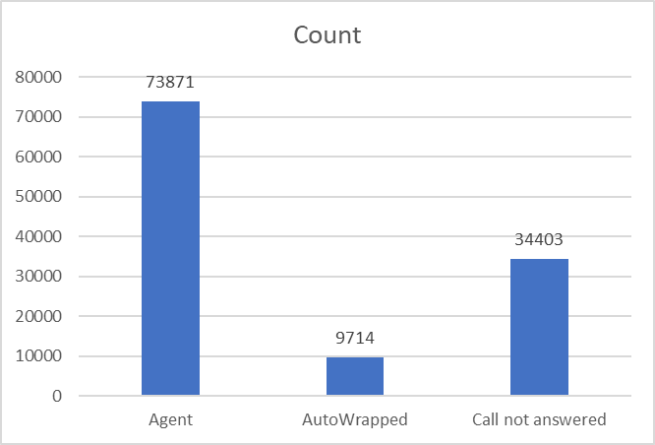
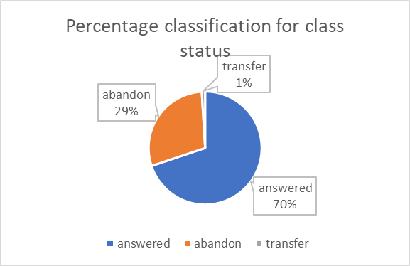
Table for Wrapped_by Column:
Table for Call_Status Column

Slide 5
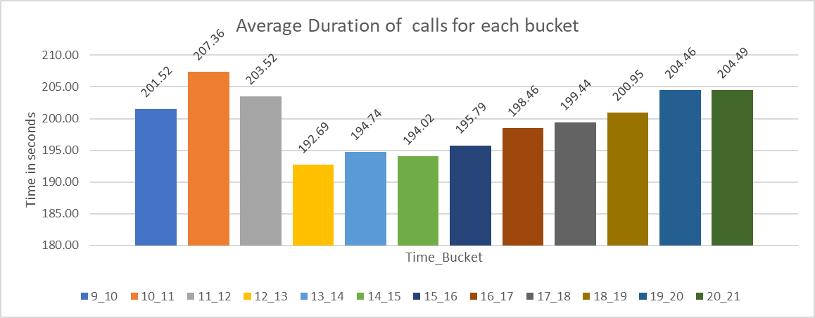
Average Call Duration: Determine the average duration of all incoming calls received by agents. This should be calculated for each time bucket. Your Task: What is the average duration of calls for each time bucket?

Slide 6
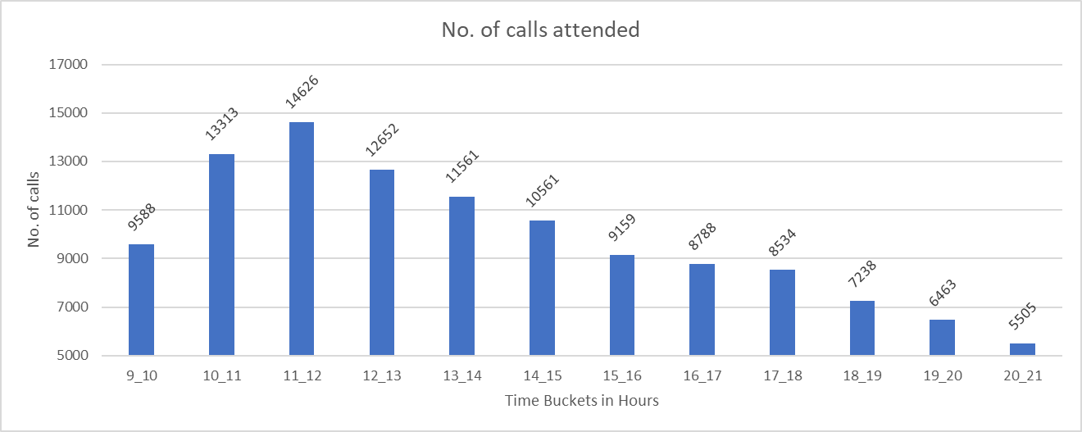
Call Volume Analysis: Visualize the total number of calls received. This should be represented as a graph or chart showing the number of calls against time. Time should be represented in buckets (e.g., 1-2, 2-3, etc.). Your Task: Can you create a chart or graph that shows the number of calls received in each time bucket?

Slide 7
Manpower Planning: The current rate of abandoned calls is approximately 30%. Propose a plan for manpower allocation during each time bucket (from 9 am to 9 pm) to reduce the abandon rate to 10%. In other words, you need to calculate the minimum number of agents required in each time bucket to ensure that at least 90 out of 100 calls are answered. Your Task: What is the minimum number of agents required in each time bucket to reduce the abandon rate to 10%?
Formulae Used:
Call Handling capacity = (working time in seconds)*(occupancy)/Average call handling time
Minimum agents Required = Total Incoming calls/Call Handling Capacity
Here,
Working time in seconds = 60*60 = 3600 seconds
Occupancy = 60% = 0.6
Firstly, the Average call handling time was calculated using the Sumif function on the time_bucket column and call seconds and then this value is used for the calculation of Call Handling Capacity and Minimum Agents Required Formulae

Slide 8
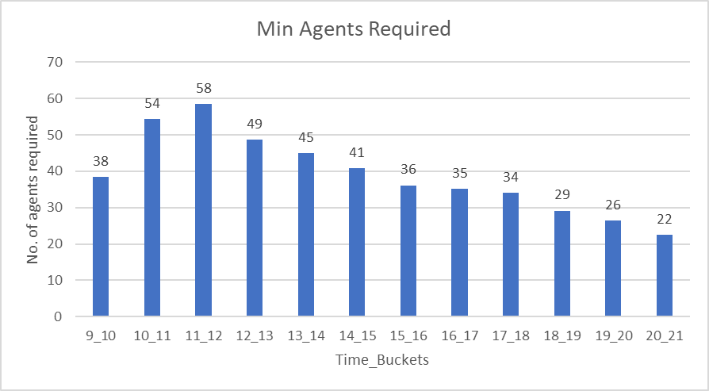
It can be seen from the graph that the Maximum no. of agents required is for the 11 AM to 12 PM time bucket because of the highest number of calls being approached to the call center followed by the 10 AM to 11 PM time bucket

Slide 9
Night Shift Manpower Planning: Customers also call ABC Insurance Company at night but don't get an answer because there are no agents available. This creates a poor customer experience. Assume that for every 100 calls that customers make between 9 am and 9 pm, they also make 30 calls at night between 9 pm and 9 am. The distribution of these 30 calls is as follows: Your Task: Propose a manpower plan for each time bucket throughout the day, keeping the maximum abandon rate at 10%.
Formulae Used:
Call Handling capacity = (working time in seconds)*(occupancy)/Average call handling time
Minimum agents Required = Total Incoming calls/Call Handling Capacity
Here,
Working time in seconds = 60*60 = 3600 seconds
Occupancy = 60% = 0.6
Firstly, the Average call handling time was calculated using 30% of the average call Handling time from the Day shift Table obtained in the slide above.

Slide 10
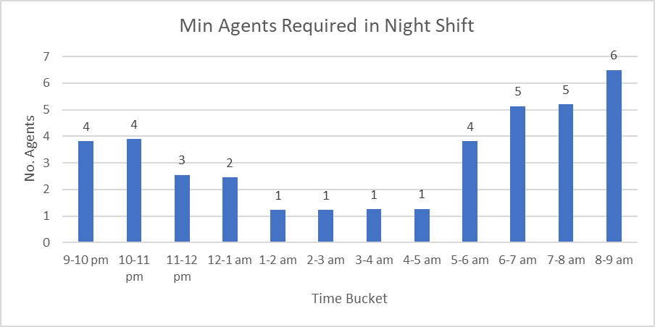
The maximum amount of agents are required in the 8-9 am time slot followed by 6-7 am and 7-8 am time slots

Slide 11
Conclusion:
For the Increase in call handling rate in the workplace, it is necessary to increase the amount of agents.
In this project, an increase of 40 agents is required to decrease the abandon rate to 10%
For Night shifts, the Facility that implements an overflow system that collects information or provides automated assistance during this time should be done.
Designating a smaller team or a smaller number of agents available during the night hours to handle urgent or high-priority calls should be done.

